Slide 1
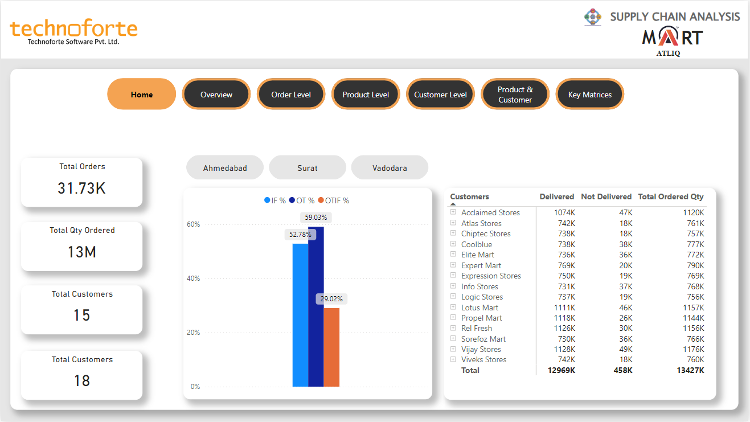
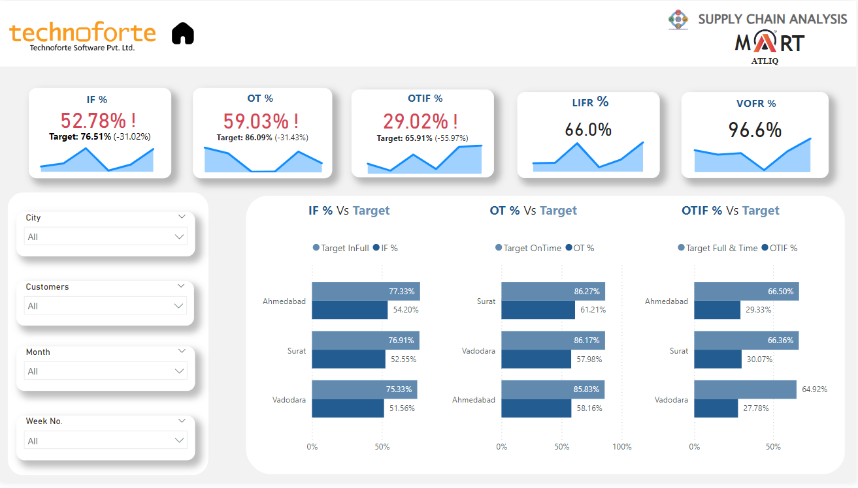

Slide 2
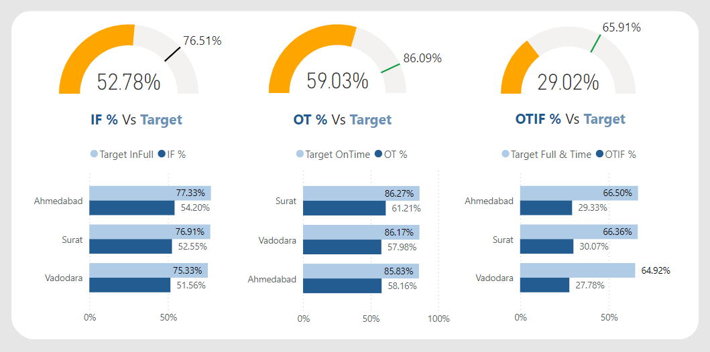
KPI -
Average OT% and IF% are noticeably
lower than the Targeted levels. If we Look at OTIF % it’s in the Same situation like IF% and OT% and it’s not what we are expecting. It’s not even meeting the half of Target.

Slide 3
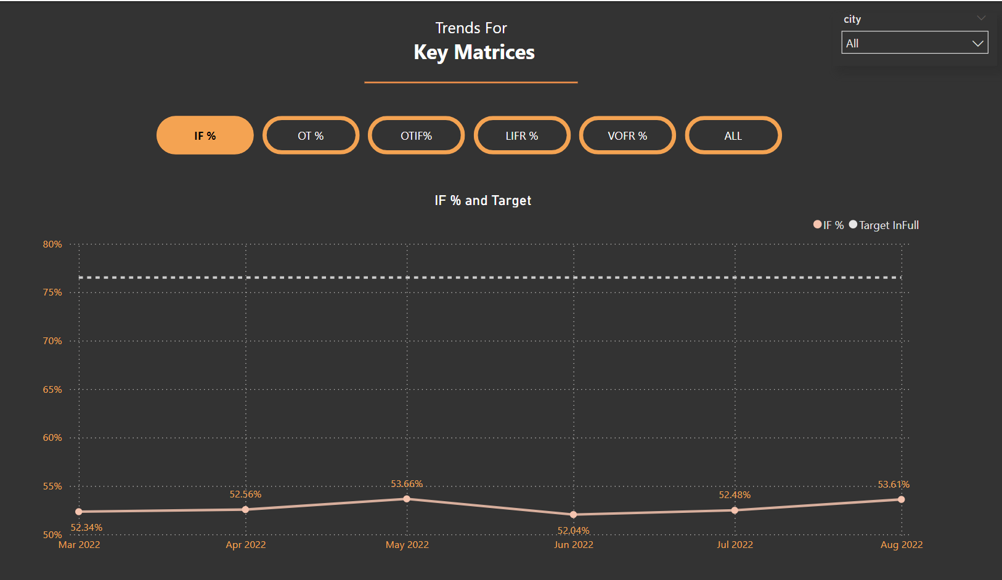
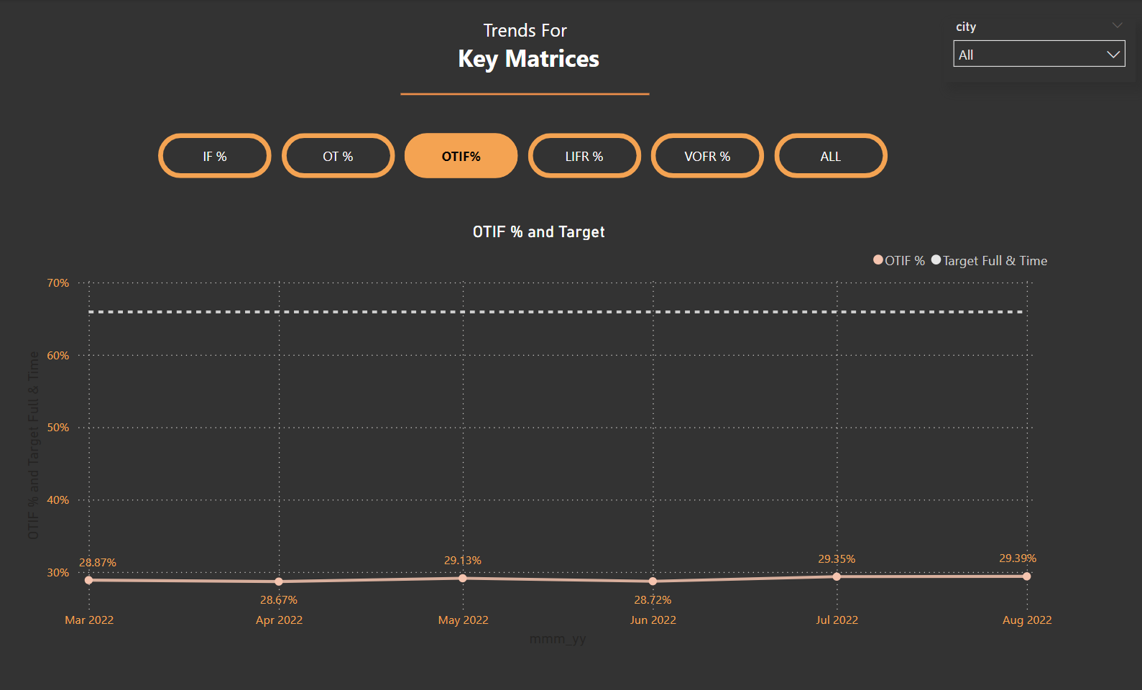
1. MAY’22 and AUG’22 are the two months where IF% and OTIF %
have shown slight improvement compare to past month, still they are
far away from Target levels
2. In Daily Trend for OT% Graphs for Order even
Daily level of OT% too are significantly lower than
Targeted OT%
As we see in above slide only 59.03% of total
orders are delivered on time
3. Even Daily trends of IF% and OTIF % chart
shows that not a single day they are able to
touch the Target lines for respective matrices.
Especially OTIF% performance is quite
disappointing.
The average OTIF% is significantly lower than the
Targeted OTIF % Which shows poor delivering
capabilities.

Slide 4
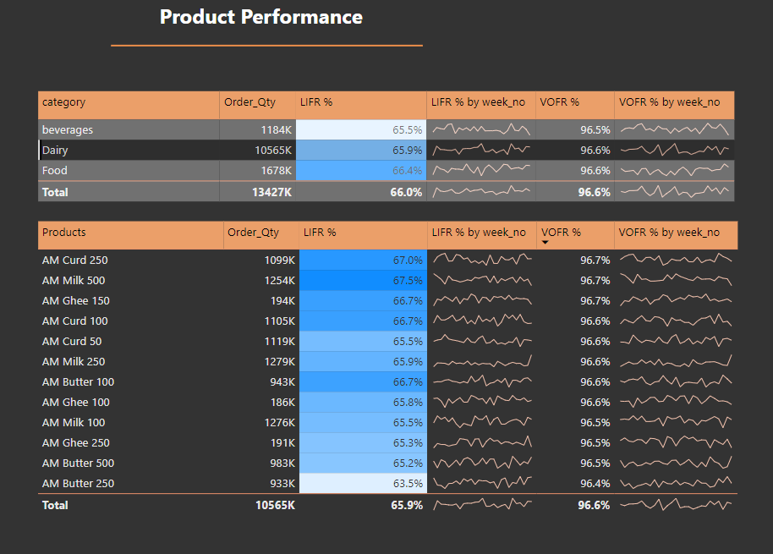
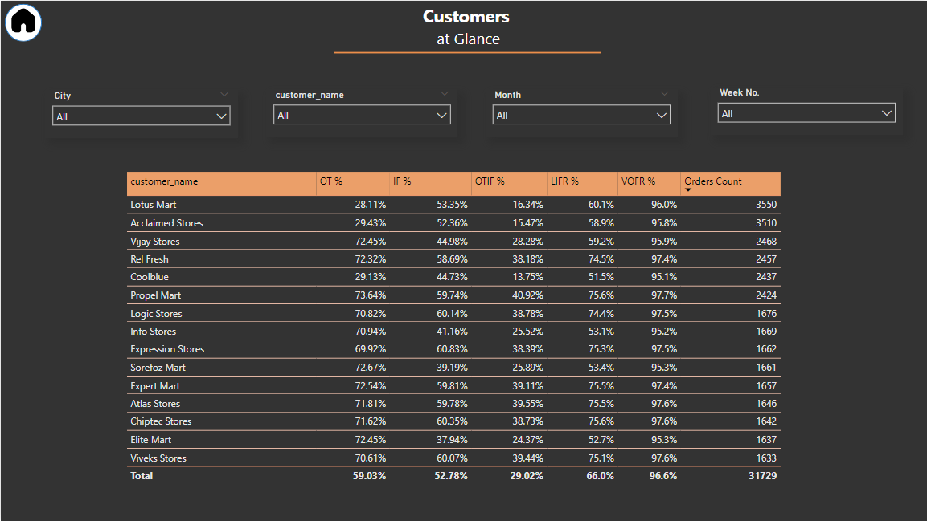
Product Level
Diary products orders are almost double than the
Food and Beverages Category. Products - AM Milk 100
- AM Milk 250 - AM Milk 500 - AM Curd 50
- AM Curd 100
- AM Curd 250
Customer Level
3 First 6 Customers Acclaimed Stores , Lotus Mart, Vijay Stores, Rel Fresh, Cool Blue & Propel Mart is constituting 53% of Total orders & seems to be key customers

Slide 5
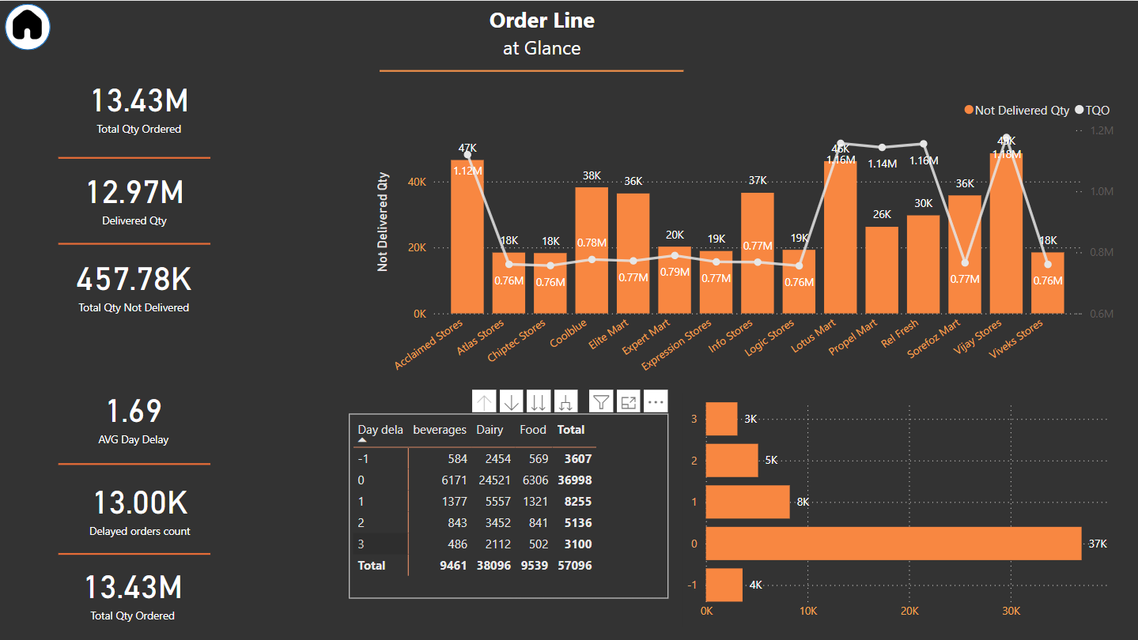
Order Line -
1. Initial analysis of Order Line overview shows that there are certain customers who has
LIFR % noticeably lower than Average LIFR%.
- Acclaimed Stores , Cool Blue, Elite Mart, Info Stores, Lotus Mart, Sorefoz Mart & Vijay Stores
- Out of That Acclaimed Stores , Lotus Mart & Vijay Stores are the customers who have larger no. of order lines amongst all
2. Further detailed analysis of Line lead time analysis combined with delayed days analysis reveals some interesting facts
-
For Acclaimed Stores , Cool Blue & Lotus Mart more than 75% of times lines are
being delivered late. Moreover, out of that 75% delayed deliveries, 66% of them are late by 2 or 3 days.
Mostly orders which are getting delay are from the Dairy Product - demand can be high and we are not able to supply on the time

Slide 6
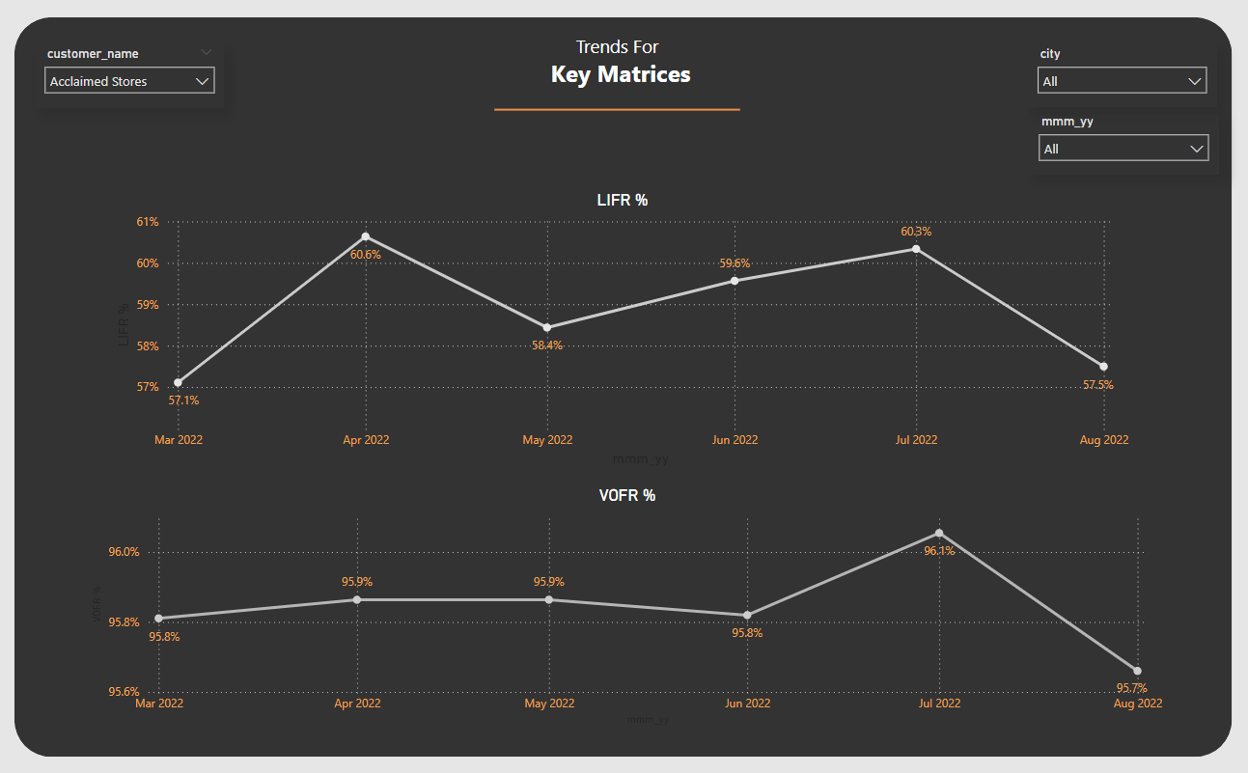
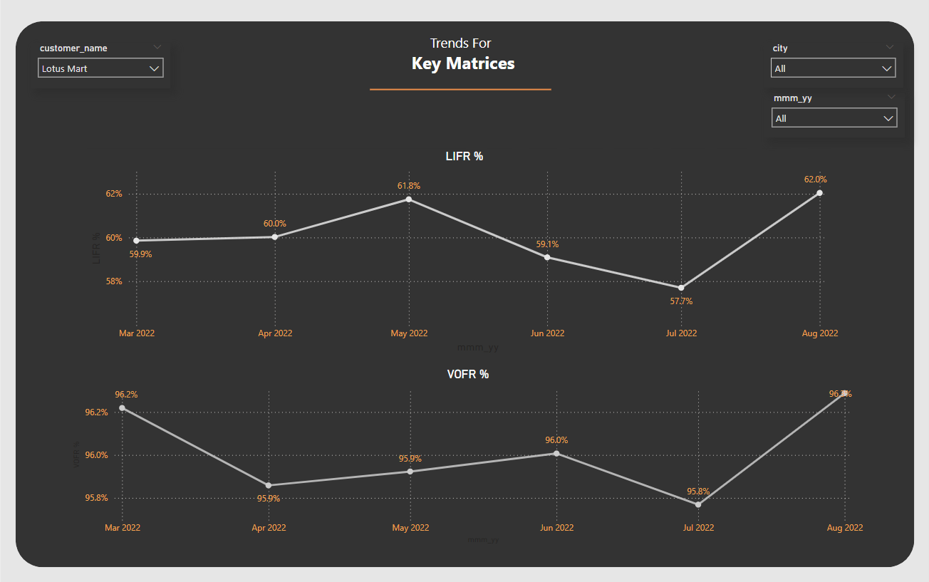
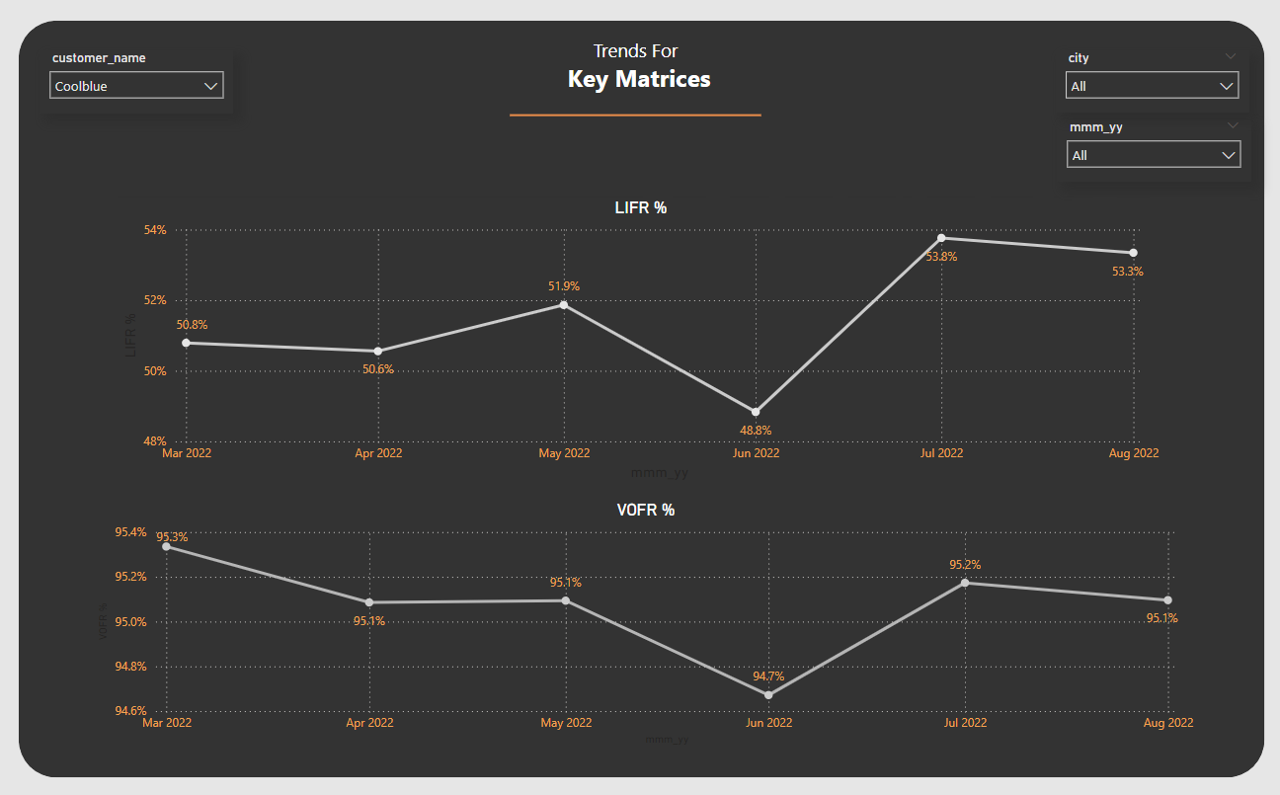
Key Matrices- Look at the chart in all these three Stores Acclaimed Stores , Cool Blue & Lotus Mart, VOFR % is good but we Are not able to complete the delivery Qty and the ratio is in front of you, it’s lower then the Ordered QTY.

Slide 7
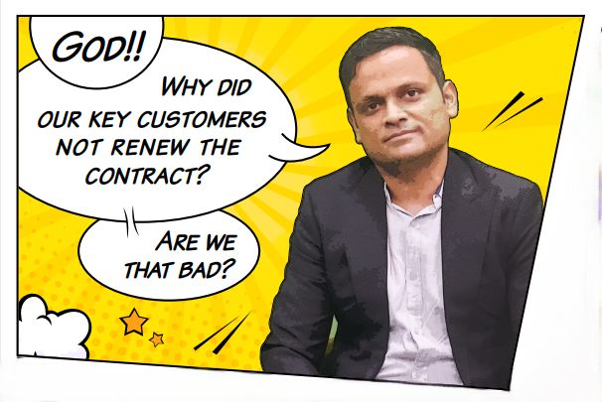
<
Unfortunately ,The Answer is YES!!
And probably Acclaimed Stores , Cool Blue & Lotus Mart are the Key customers who would certainly not willing to renew the contract.

